Slide 1
Notes

Slide 2
Mediktor- Case study on cloud
Mediktor is the world’s most advanced and accurate symptom checker for pre-diagnosis, triage and decision-making support. Founded in Barcelona, Spain, in 2011, the company has developed an artificial intelligence solution that users can easily interact with by describing their symptoms in natural language. Designed to be easily integrated with healthcare payers and providers, the Mediktor technology offers the potential to dramatically reduce unnecessary expenditure, and helps people make smarter, safer decisions when they feel unwell.

Slide 3
Mediktor Improving access to healthcare through AI-based symptoms assessment in the Cloud

Slide 4
Mediktor- Case study on cloud
Mediktor is an AI-assisted online symptom-assessment technology, powered by IBM® Cloud™, which integrates seamlessly into healthcare payers’ and providers’ online services and workflows.

Slide 5
Business challenge
21st century medicine is a high-pressure environment. As the cost of care continues to increase, healthcare providers around the world are struggling to maintain standards of care while working within ever-tighter financial constraints.
Meanwhile, emergency rooms are overflowing with people whose problems could be solved more effectively via alternative channels, such as an online chat or video consultation. Each of these cases diverts valuable time and resources away from seriously ill patients. Many health services run campaigns to raise awareness of this issue and discourage people from coming to the ER with minor illnesses. However, it is better for people to see a doctor unnecessarily, than for them to underestimate the risks and stay home when their condition might be serious.

Slide 6
Mediktor: realized the problem
Mediktor’s answer is to harness artificial intelligence to analyze a person’s symptoms and provide objective information to help them decide on their next step: for example, whether they should speak to a doctor online, make a face-to-face appointment at a local clinic, go straight to the ER, or even call an ambulance.

Slide 7
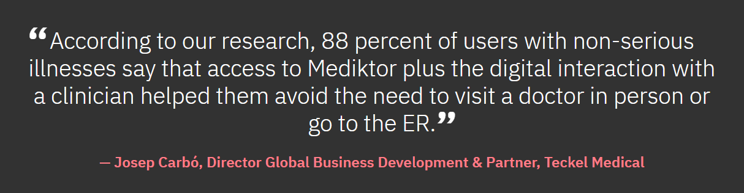

Slide 8
Challenges
To bring new clients on board, there is need to be able to create servers on demand and put them into production quickly.
To respond to clients’ needs, we need rapid scalability, high availability, and low latency. A cloud infrastructure was the only option that would give us these properties

Slide 9
A cloud infrastructure was the only option that would give these properties

Slide 10
Infrastructure-as-a-service
Given the complex regulations imposed on IT services in different countries, it proved difficult for Mediktor to find software-as-a-service or platform-as-a-service cloud solutions that would meet all its requirements.
A lower-level, infrastructure-as-a-service strategy based on IBM Cloud Virtual Servers proved to be the best option.
“IBM Cloud Virtual Servers offered us a high degree of visibility for the hardware, and the ability to configure and adapt this hardware to our specific needs, in ways no other software provider with the same levels of technical power can offer right now,” says Roger Forcada.

Slide 11
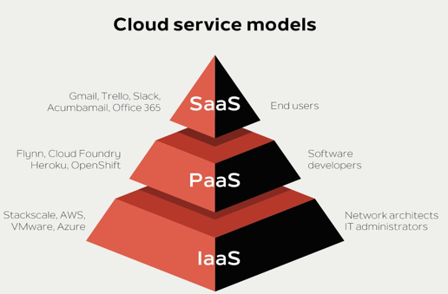
Service Models
https://www.stackscale.com/blog/cloud-service-models/

Slide 12
Results story
Since launch, the company has also gathered valuable insight into how and when patients engage with the service. For example, across all user interactions, approximately 85 percent of cases are non-serious, 10 percent are moderate, and only 5 percent are urgent or emergency—so the vast majority of users do not need to visit a doctor or go to the ER.
IBM Cloud provides a flexible, reliable and cost-effective platform that enables Mediktor to make its services available to clients in many countries around the world.

